Slide 1



June 2
2025
2pm-3pm ET
Prostate Cancer Risk Assessment and Screening for Clinicians

Slide 2




Thank You to Our Sponsors!
Pfizer has provided funding to ACS in support of the launch of “Change the Odds: Uniting to Improve Cancer Outcomes™,” a new initiative to start creating change where it is most urgently needed: in communities disproportionately impacted by breast and prostate cancer.

Slide 3
Ground Rules
1
Nonpartisan Commitment & Discussion Guidelines
ACS/ACS CAN is a nonprofit, nonpartisan organization. We believe everyone should have a fair and just opportunity to prevent, detect, treat, and survive cancer. We therefore ask that you avoid partisan topics and opinions today.
2
ACS National Roundtable Rules for Engagement
Rules for engagement clarify the expectations for participation by members and representatives of the ACS NPCRT. Members are expected to respect and comply with these Rules and all other applicable ACS policies.
3
Confidentiality
This webinar is being recorded. Please be mindful of our conversation and respectful of others’ privacy. Do not identify or discuss specific patients by name.

Slide 4
General Webinar Housekeeping
Please remain with your camera off during the webinar.
Please remain muted throughout the duration of the webinar.
We encourage you to ask questions as they arise in the chat.
Q&A will commence at the end of the webinar.
Please remain courteous while engaging in the chat box.
4

Slide 5
1. To learn why PSA testing is important, particularly in at-risk individuals.
2. To be able to implement basic risk assessment and shared decision-making practices for prostate cancer screening
3. To be able to determine if/when to start recommending PSA testing on a patient-by-patient basis through effective shared decision making
Learning Objectives

Slide 6



ACS NPCRT Team Members
Sarah Shafir, MPH
VP, National Roundtables and Coalitions
Lucas Brand, PhD
Strategic Director, NPCRT
Nyyah Green, MPH
Program Manager, NPCRT

Slide 7

Pre-Test Poll

Slide 8

Meet The Experts
Richard C. Wender, MD
Chair, Family Medicine and Community Health
University of Pennsylvania Perelman School of Medicine

Slide 9

Meet The Experts
Timothy R. Rebbeck, PhD
Vincent L. Gregory, Jr. Professor of Cancer Prevention
Harvard T.H. Chan School of Public Health and Dana-Farber Cancer Institute

Slide 10
Disclosures
Richard C. Wender, MD: nothing to disclose.
Timothy R. Rebbeck, PhD: nothing to disclose.
10

Slide 11
Prostate Cancer

Slide 12
2025 Prostate Cancer Cases and Deaths
In 2025, the American Cancer Society estimates that:
  313,000 med will be diagnosed with prostate cancer
  35,700 men will die from this disease
28,900 men will die from colorectal cancer in 2025
Average age of death: 79.5

Slide 13
The Prostate Cancer Screening Conundrum: It’s Chiefly a Disease in Older Men
1 in 8 men will be diagnosed in their lifetime.
6 in 10 are diagnosed in men ages 65 or older.
Average age of diagnosis is 67 – but risk of developing prostate cancer keeps going up with age.

Slide 14
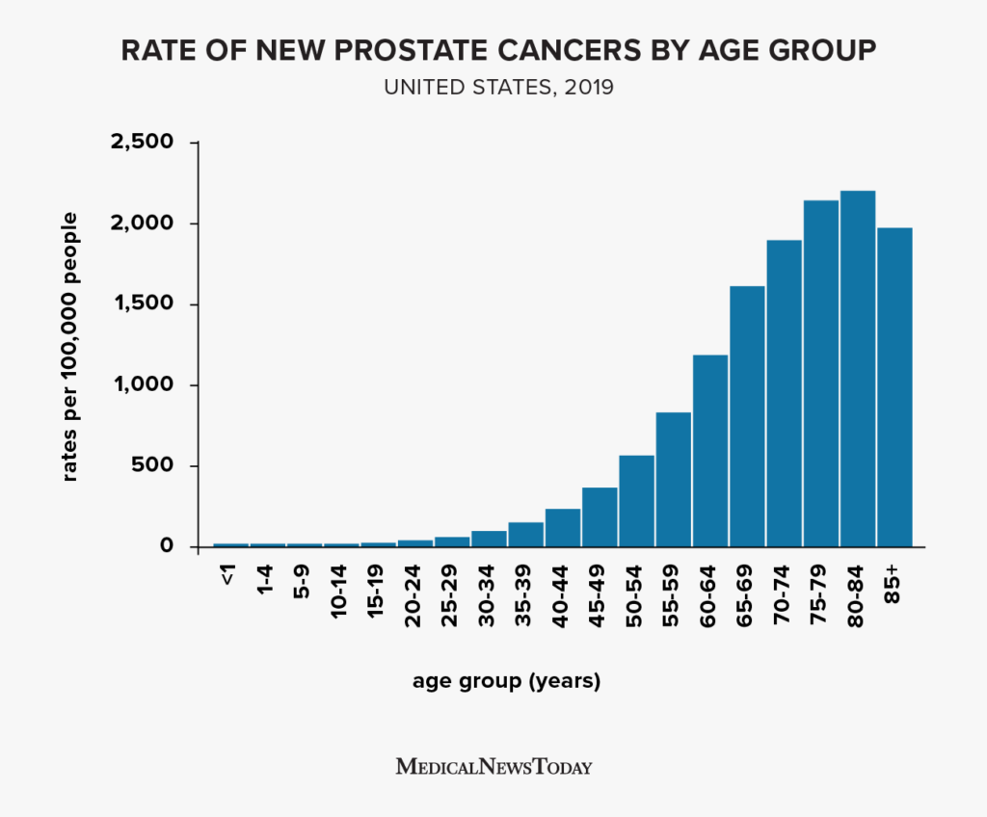

Slide 15
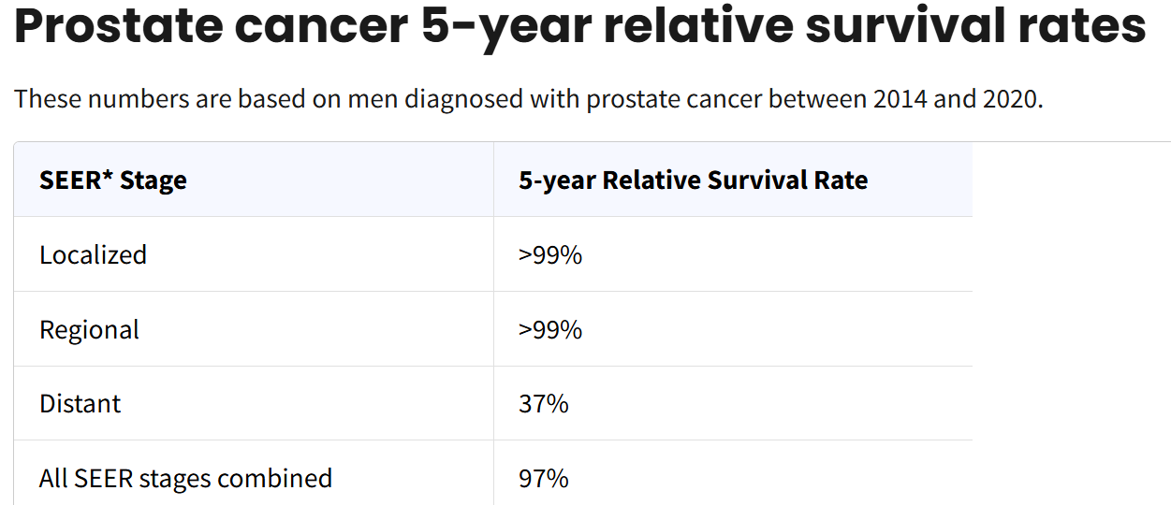
And Most Men Live a Long Time With Prostate Cancer

Slide 16
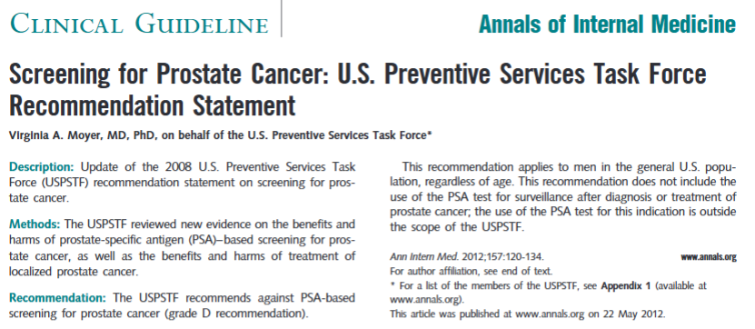
USPSTF 2012 Guideline: A Recommendation Against Screening

Slide 17
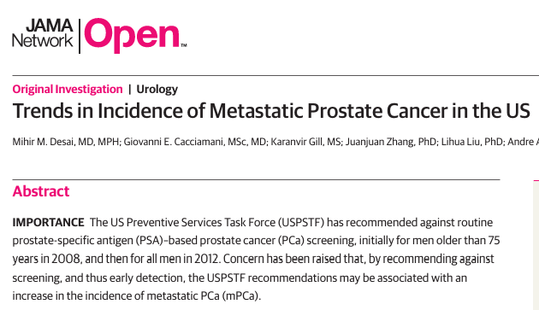

Slide 18
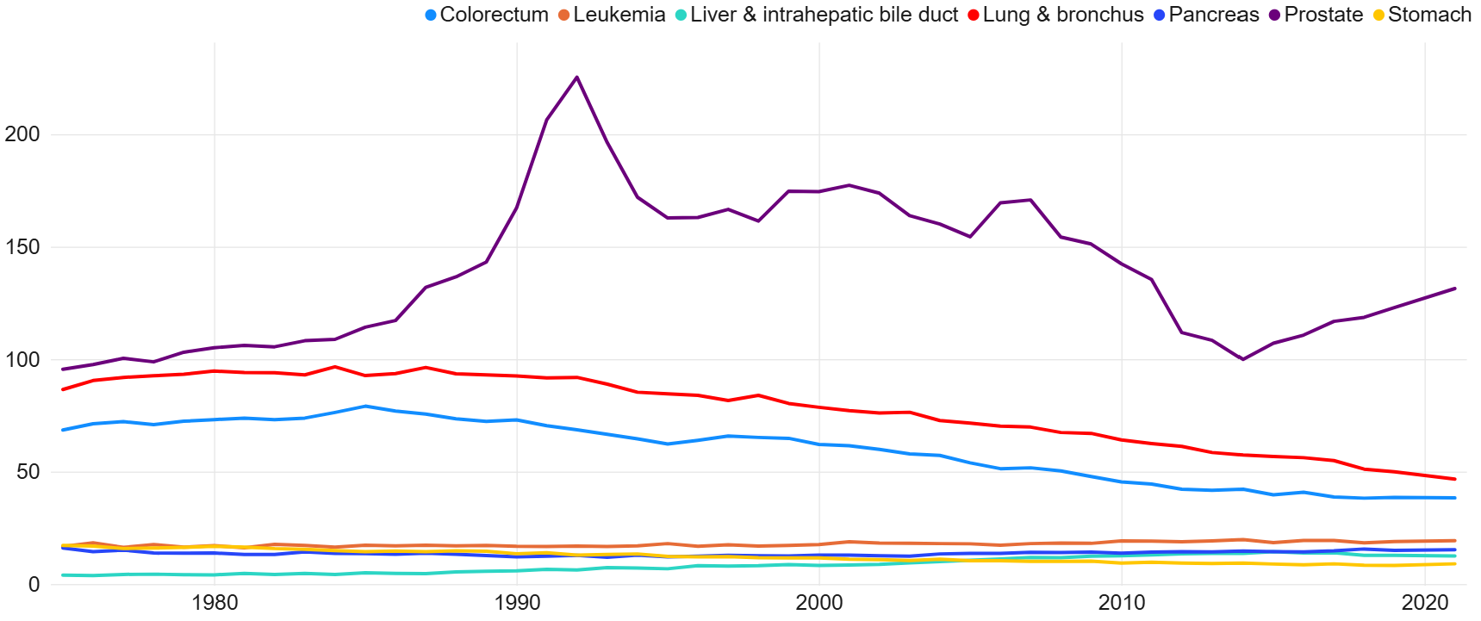
USPSTF D recommendation
NEJM article about PSA and 1992 ACS guideline
Rise in metastatic prostate cancer

Slide 19
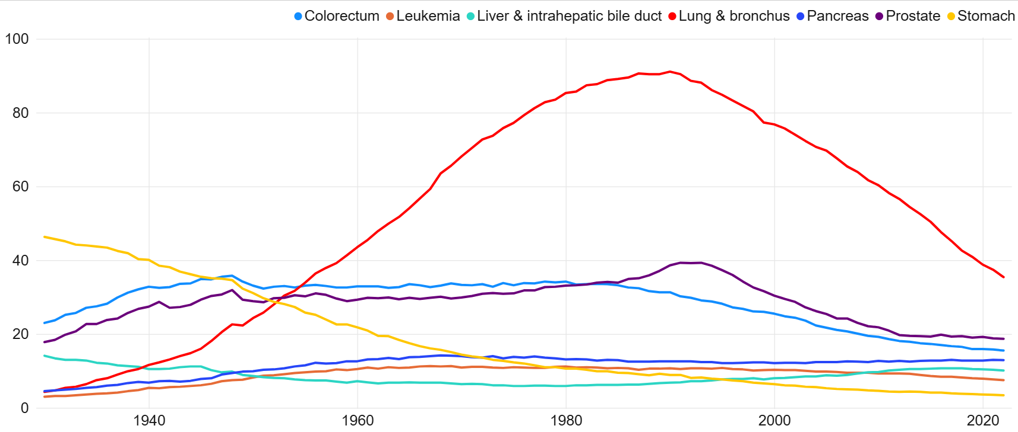
Cancer Deaths in Men Through 2022

Slide 20
American Cancer Society Guideline: 2010
Average Risk: Following a discussion about uncertainties, risks, and potential benefits, men who want to be screened should have a PSA with or without rectal exam.
If result is 2.5 ng/ml or greater, should be repeated annually.
High risk: Start at age 45 and screen annually.

Slide 21
Defining Risk:
African American or African Caribbean men are at high risk and should start at age 45.
Men with 2 or more first degree relatives.
Men with a close relative diagnosed at an early age should be referred for genetic testing and should consider screening as early as age 40.

Slide 22
USPSTF Guideline Update: 2018
Men 55 – 69 may choose to be screened with a PSA following a shared decision-making process. No comment on frequency of testing.
While acknowledging that men of African-descent and men with a family history are at higher risk, they do not recommend a different starting age or frequency.

Slide 23
USPSTF Guideline: 2018
“Screening offers a small potential benefit of reducing the chance of death from prostate cancer in some men. However, many men will experience potential harms of screening, including false-positive results that require additional testing and possible prostate biopsy; overdiagnosis and overtreatment; and treatment complications, such as incontinence and erectile dysfunction.”
Clinical Summary: Prostate Cancer: Screening | United States Preventive Services Taskforce

Slide 24
USPSTF Guideline (cont.)
“ . . . Patients and clinicians should consider the balance of benefits and harms on the basis of family history, race/ethnicity, comorbid medical conditions, patient values about the benefits and harms of screening and treatment-specific outcomes, and other health needs.”

Slide 25

Who Wants a PSA Test Now?!?

Slide 26
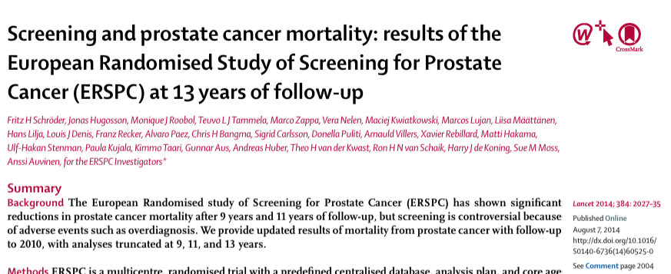
A New Trial Found Much Larger Benefit from PSA Screening

Slide 27
ERSPC Design and Key Findings
Men ages 50 – 74 in eight European countries
Outcomes reported for core age group: 55 – 69
7408 cases in the screening group and 6107 in the control group.
  Incidence ratio 1.91 at 9 years
  1.66 at 11 years
  1.57 at 13 years

Slide 28
ERSPC Mortality
Absolute risk reduction:
  0.85 at 9 years
  0.78 at 11 years
  0.79 at 13 years
After adjustment for non-participation, the mortality rate ration was 0.73
One prostate cancer death averted per 781 men invited.

Slide 29
Modeling Study on Benefit of Screening
With screening every 4 years in 1000 men:
  52 life-years gained
  41 quality of life-adjusted life years (QALYs)
  Heijnsdijk EA, Wever EM, et.al. N Engl J Med. 2012 Aug 16;367(7):595-605..

Slide 30
American Urologic Association Prostate Cancer Screening Guideline
A high-quality guideline that follows the strictest standards for guideline design
It’s more up to date and offers far more specific clinical guidance than the ACS or USPSTF guideline.
Early Detection of Prostate Cancer: AUA/SUO Guideline (2023) - American Urological Association

Slide 31
AUA Recommendations
1 and 2. Clinicians should engage in Shared Decision Making. Screening should be conducted with PSA.
3. For people with a newly elevated PSA, the test should be repeated before doing any other evaluation.
4. Clinicians may begin screening and offer a baseline PSA between 45 and 50 years.

Slide 32
A Baseline PSA Can Be Very Helpful
“Baseline PSA was a stronger predictor of prostate cancer risk than race and family history of prostate cancer.”
“For patients aged 45 to 49 years with PSA below the median (0.68 ng/mL), the risk of prostate cancer metastasis within 25 years was 0.85%.”
“Patients with PSA in the highest decile (≥ 1.6 ng/mL) at ages 45 to 49 years contributed to nearly half of prostate cancer deaths over the next 25 to 30 years.”

Slide 33
AUA Recommendations
5. “Clinicians should offer prostate cancer screening beginning at age 40 to 45 years for people at increased risk of developing prostate cancer based on the following factors: Black ancestry, germline mutations, strong family history of prostate cancer.”

Slide 34
AUA Recommendations
6. Offer PSA every 2 to 4 years ages 50 to 69.
7. Patients may decide to discontinue screening or screen more or less frequently based on a variety of considerations, including life expectancy.

Slide 35
More AUA Recommendations
Prior to biopsy, patients should be aware that they might have a prostate cancer that doesn’t require immediate treatment.
Multi-parametric MRI can be obtained prior to biopsy. Abnormal findings should guide the biopsy.
If MRI is negative, men with a higher risk of clinically important prostate cancer may still need to undergo biopsy.

Slide 36
AUA Recommendations: Urine and Serum Markers
Should only be used when the decision to perform a biopsy is not clear. (e.g. PSA 2.5 – 9.9 ng/ml in a young patient).
  Percent free PSA: Lower results are associated with higher cancer risk.
  Higher PSA density associated with higher risk.
  Post-DRE urinary PCA3 – an emerging biomarker with predictive utility

Slide 37
Shared Decision Making
Every guideline recommends SDM.
The content and emphasis of the SDM can and do vary substantially.
Numerous studies demonstrate the benefit of using a validated decision aid – at least people are more likely to be informed and to feel confident in their decision.
BUT – primary care-based SDM often does not occur and the quality is usually quite low.

Slide 38
Prostate Cancer Screening: Where Do We Go From Here?
We need to re-commit to offering PSA screening.
Embed decision aids and clinical prompts into EMR.
Primary care clinicians should become more comfortable with managing elevations in PSA.
The ultimate goal is to continue to improve the balance of benefits and harms of PSA screening so that screening can be recommended for everyone – without the need for shared decision making.

Slide 39

Understanding Prostate Cancer Screening

Slide 40

Goals of Prostate Cancer Screening
Early Detection
Minimize Harm
Find cancer before it spreads
Avoid overdiagnosis of slow-growing cancers
Informed Decisions
Balance benefits and risks with personal values

Slide 41
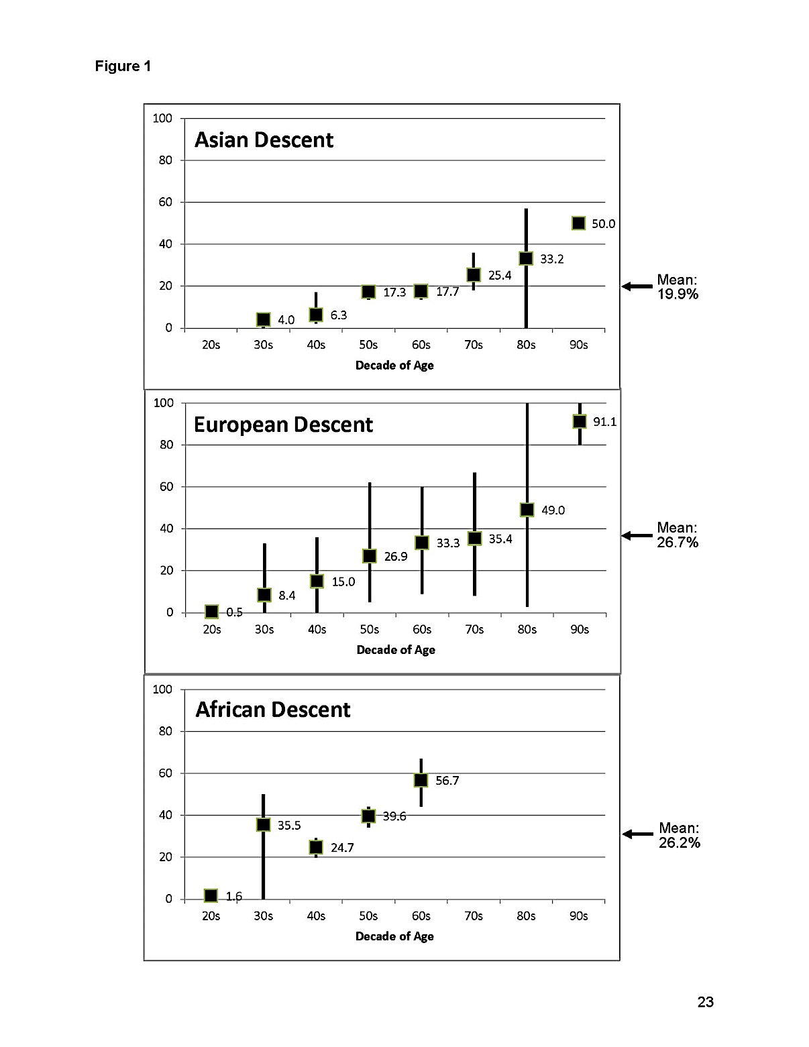
Autopsy Prevalence of Prostate Cancer:
30’s
50’s:
80’s:
4%
8%
?
17%
27%
40%
33%
49%
>50%
If you screen, you will find a lot of prostate cancer.
Most prostate cancer is indolent and does not need treatment.

Slide 42




Potential Harms of Screening
Psychological Impact
Anxiety from false positives and cancer diagnosis
Biopsy Complications
Pain, bleeding, infection (0.4% develop sepsis)
Treatment Side Effects
Incontinence, erectile dysfunction, bladder and bowel problems
Overdiagnosis & Overtreatment
Treatment of cancers that would never cause harm

Slide 43
Population Observations on PSA Screening
Late 1980s
PSA testing came into common use for early diagnosis of prostate cancer.
Early 1990s
Incidence rates initially rose dramatically as first-time PSA screening became widespread, followed by a subsequent decline.
Mid 1990s
Mortality rates began to decrease, though the relationship between this decline and screening intensity remains unclear and inconsistent.
2000s
By 2005, ~90% of prostate cancers were clinically localized: Stage shift
Randomized clinical trials studied whether a mortality benefit is associated with PSA screening.
2010’s and forward
Following USPSTF downgrades (2012, 2018) mortality rates began to creep back up.

Slide 44
Clinical Trial Evidence
Study | Location | Design | Intervention/Randomization | PSA cutpoint deemed positive (ng/ml) | Effect of Screening on PC Mortality (yrs followup)
PLCO | US | 76,693 men Ages 55-74 | Annual PSA for 6 years + DRE years 1-4 vs. Usual Care (Up to 52% PSA contamination in control group) | >4.0 Biopsy protocol not standardized across centers | No difference (15 year follow up)
ESRPC | Europe | 182,000 men Ages 50-74 | PSA screening at an average of once every 4 years vs. No screening | >1.8 Protocols differed among countries | 20% reduction (9 year follow up) NNS: 781 NNT: 27
CAP | UK | 189,386 men in the intervention group; 219,439 controls | In the intervention group, 40% of men attended a PSA testing clinic, and 36% had a PSA blood sample taken vs. no screening. | >3.0 | No difference (10 year follow up)
Göteborg | Sweden | 20,000 men Ages 50-64 | PSA testing every 2 years vs. no testing | >2.5 | 35% reduction (18 year follow up)
Harms usually accrue early; Benefits take time to emerge

Slide 45
If PSA screening has unclear mortality benefit overall,
and may cause greater harm than benefit to some,
can we find better ways to screen?

Slide 46
Digital Rectal Examination (DRE)
Examination Technique
Effectiveness Limitations
Uncertain Benefits
Inexpensive and relatively noninvasive procedure. Can be taught to healthcare workers at various levels.
Accuracy depends on examiner skill. Positive predictive value is only 25-29% for palpable nodules.
Contribution to reducing prostate cancer mortality remains undetermined. Poor predictive value when PSA levels are low.
DRE may pose a barrier without providing clear overall benefits.

Slide 47

Risk-Adaptive Approaches
Age
Risk increases with age
Genetics & Family History
2-3x risk with first-degree relatives affected
~9x risk with affect father and brother
Race/Ethnicity
Higher incidence in African American men
Anthropometrics
Height and obesity linked to aggressive disease
These factors are not (or not easily) modifiable
Some may serve as stratifiers for screening protocols
Risk assessment tools exist that may guide screening decisions

Slide 48
Germline Genetics in Prostate Cancer
Low Penetrance Cancer Genes: >451 Unique Loci Explaining ~1/3 of familial risk
High Penetrance Cancer Genes:
*Metastatic Cancer: 11.8%
*Localized Disease: 4.6%
ATM
ATR
BRCA1
BRCA2
BRIP1
CHEK2
FAM175A
GEN1
HOXB13
Lynch Syndrome (MLH1, MSH2, MSH6, PMS2)
MRE11A
NBN
PALB2
RAD51C
RAD51D
TP53
Strong Evidence
Moderate Evidence
Weak Evidence
Men who test positive for high penetrance cancer genes should seek specialist input
*Pritchard et al. NEJM 2016

Slide 49
Possible Approaches to Improve
PSA Testing Performance
Complexed PSA and %Free PSA
Other tests
PSA Velocity
May improve sensitivity and specificity compared to total PSA alone, particularly in the diagnostic "gray zone" of 2.5-4.0 ng/ml
Third generation PSA, 4K, PHI, others.
Clinical usefulness remains unproven.
Measuring PSA change over time has had mixed results.
Insufficient data to guide use

Slide 50
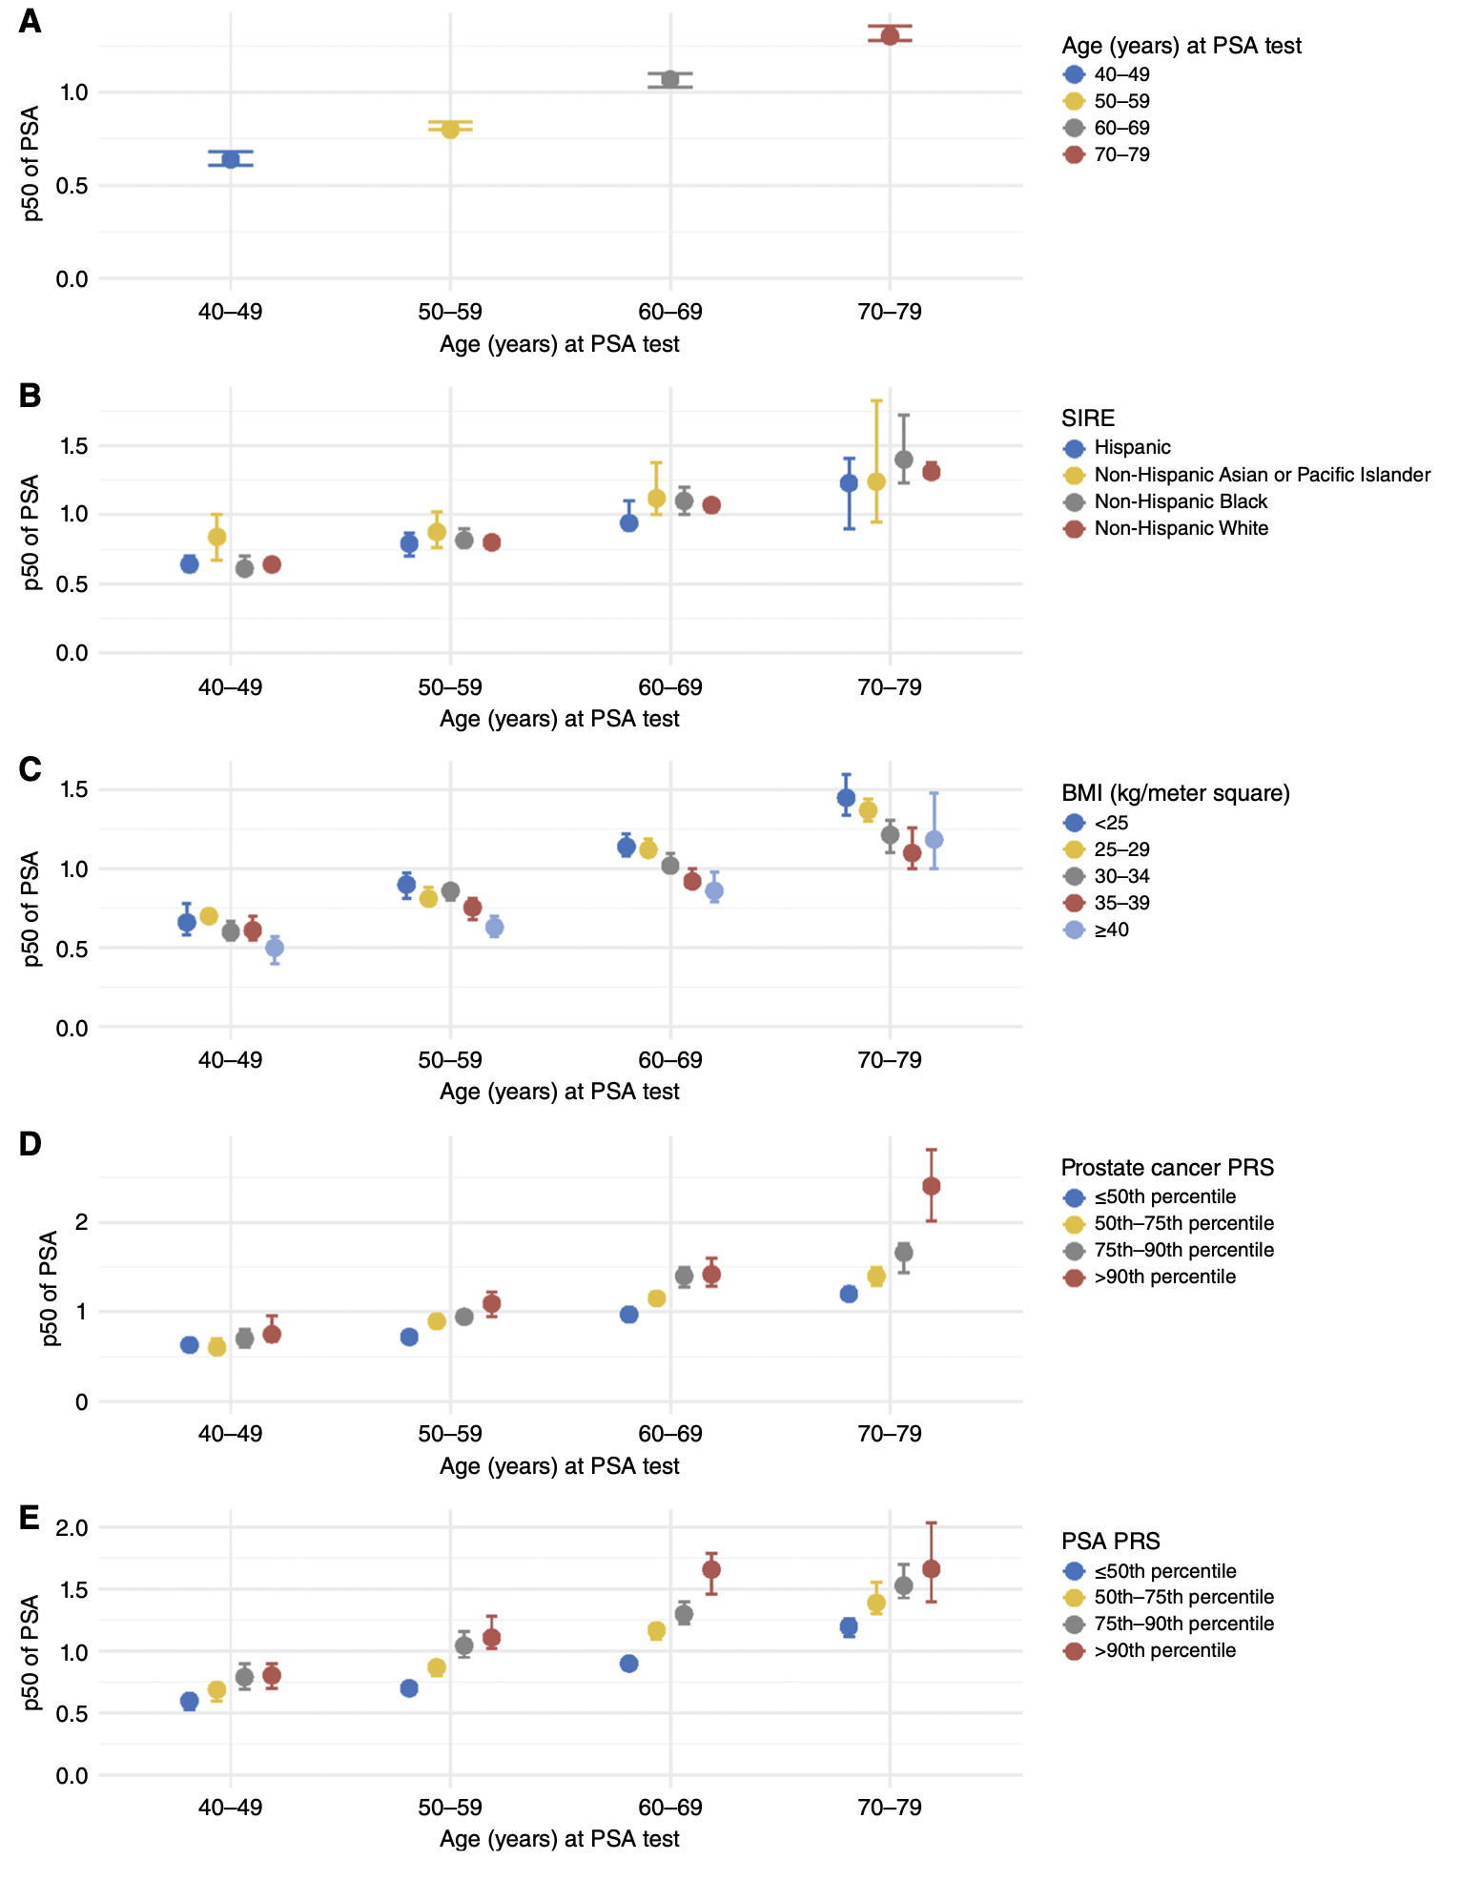
PSA Varies by Age, BMI, Race/Ethnicity, Ancestry
Kensler et al, CEBP 2025

Slide 51
Factors That Affect PSA Readings
Factors That May Raise PSA
Factors That May Lower PSA
Advanced age
5-alpha reductase inhibitors
Enlarged prostate (BPH)
Some herbal supplements
Prostatitis (inflammation)
Aspirin (long-term use)
Recent ejaculation
Statin medications
Vigorous exercise
Thiazide diuretics
Urologic procedures
Testosterone medications

Slide 52
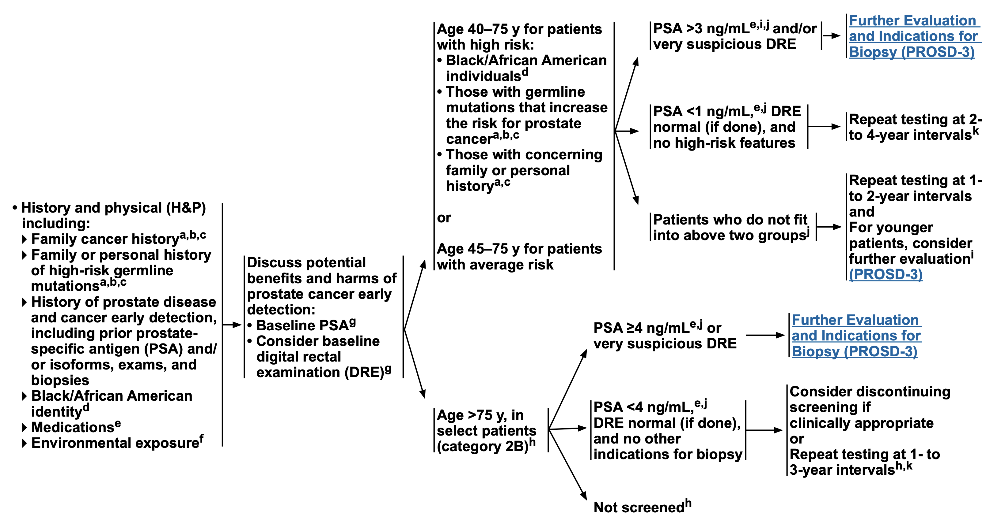
NCCN Guidelines: Age, Race, Genetics, PSA Cutpoints
NCCN, March 2025

Slide 53
Risk Stratified and Risk Adaptive Approaches
Questions
When to start? Baseline midlife
Cadence? Frequency and modality
When to stop? Life expectancy, frailty
Pros
Can refine clinical pathways to maximize benefit and minimize harms
Cons
Adds complexity to an already difficult process

Slide 54





Reminder: PSA itself is not the enemy -
It depends how the information is used
Repeat PSA Test
Confirm elevation isn't temporary
Referral to Urologist
Specialist evaluation
Additional Testing
mpMRI (also: Free PSA, 4Kscore, or SelectMDx?)
Prostate Biopsy
If indicated by specialist
One Size Does Not Fit All

Slide 55

Q&A

Slide 56
Post-Test Poll

Slide 57

Stay Connected with ACS NPCRT
SAVE THE DATE
Upcoming ACS NPCRT Webinar:
What to Do After an Abnormal PSA Test: MRI, Biopsy, and Beyond
July 30th 3p-4p ET
Website: npcrt.org
LinkedIn: American Cancer Society National Prostate Cancer Roundtable
X: @NPCRTnews
Newsletter: Sign up at npcrt.org/about-us/
Register Here:
57

Slide 58

Thank You
Npcrt.org

