Slide 1



September 3, 2025
1:30pm-2:30pm ET
Recent Advances in the Clinical Management of Metastatic Prostate Cancer

Slide 2




Thank You to Our Sponsors!
Pfizer has provided funding to ACS in support of the launch of “Change the Odds: Uniting to Improve Cancer Outcomes™,” a new initiative to start creating change where it is most urgently needed: in communities disproportionately impacted by breast and prostate cancer.

Slide 3
Ground Rules
1
Nonpartisan Commitment & Discussion Guidelines
ACS/ACS CAN is a nonprofit, nonpartisan organization. We believe everyone should have a fair and just opportunity to prevent, detect, treat, and survive cancer. We therefore ask that you avoid partisan topics and opinions today.
2
ACS National Roundtable Rules for Engagement
Rules for engagement clarify the expectations for participation by members and representatives of the ACS NPCRT. Members are expected to respect and comply with these Rules and all other applicable ACS policies.
3
Confidentiality
This webinar is being recorded. Please be mindful of our conversation and respectful of others’ privacy. Do not identify or discuss specific patients by name.

Slide 4
General Webinar Housekeeping
Please remain with your camera off during the webinar.
Please remain muted throughout the duration of the webinar.
We encourage you to ask questions as they arise in the chat.
Q&A will commence at the end of the webinar.
Please remain courteous while engaging in the chat box.
4

Slide 5
- Develop a working knowledge of how genetics and genomics can be applied in this setting to improve patient outcomes.
- Learn about recently approved advances in therapy for late-stage prostate cancer.
- Understand how PSMA-PET tracing and other radiologic and theranostic modalities have changed the management of advanced prostate cancer.
Learning Objectives

Slide 6



ACS NPCRT Team Members
Sarah Shafir, MPH
VP, National Roundtables and Coalitions
Lucas Brand, PhD
Strategic Director, NPCRT
Nyyah Green, MPH
Program Manager, NPCRT

Slide 7

Pre-Test Poll

Slide 8

Meet The Experts
William K. Oh, MD
Director of Precision Medicine,
Yale Cancer Center & Smilow Cancer Hospital.
Service Line Medical Director,
Smilow Cancer Hospital at Greenwich Hospital

Slide 9

Meet The Experts
Evan Y. Yu, MD
Section Head and Professor, Clinical Research Division,
Fred Hutchinson Cancer Center

Slide 10

Meet The Experts
Joshua Lang, MD, MS
Professor of Medicine and Associate Director of Translations/Research,
Carbone Cancer Center, University of Wisconsin

Slide 11

Meet The Experts
Bridget Koontz, MD, FASTRO
Chair, Department of Radiation Oncology, and Medical Director,
Radiation Oncology Florida Divisions,
Adventhealth Cancer Institute

Slide 12
Disclosures
William K. Oh, MD: Consultant: Novartis, Astra Zeneca, Sumitomo, Pfizer, GSK, VieCure, Abbott, Biocartis, Neogenomics, NTxBio
Equity: GeneDx, Archetype Therapeutics, NTxBio, PrevivorCare
Evan Y. Yu, MD: Consulting: Astellas, J&J, AZ, Tolmar, Merck , Bayer, Lantheus, BMS, Loxo, AAA Novartis, Aadi Bioscience
Research funding to institution: Dendreon, Merck, SeaGen, Blue Earth, Bayer, Lantheus, Tyra
Joshua Lang, MD, MS: Founder EOLAS, Inc., Advisory Boards: Astellas, Pfizer, Gilead, Jannsen, Sanofi, Foundation Medicine, Cytogen, AstraZeneca, Arvinas, Macrogenics
Bridget Koontz, MD, FASTRO: Board Member: Rythera Therapeutics
Advisory Boards (active): FUSE Oncology
Advisory Boards (past): Blue Earth Diagnostics, Lantheus, Myriad Genetics, Novartis
12

Slide 13
Recent Advances in the Management of Advanced Prostate Cancer
William K. Oh, MD
Director, Precision Medicine
Yale Cancer Center and Smilow Cancer Hospital
Service Line Medical Director
Smilow Cancer Hospital at Greenwich Hospital
Chair, National Prostate Cancer Roundtable
American Cancer Society

Slide 14
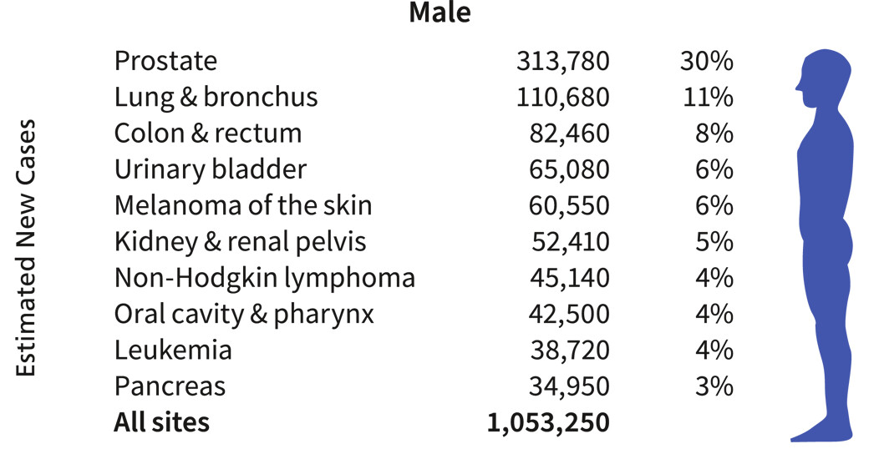
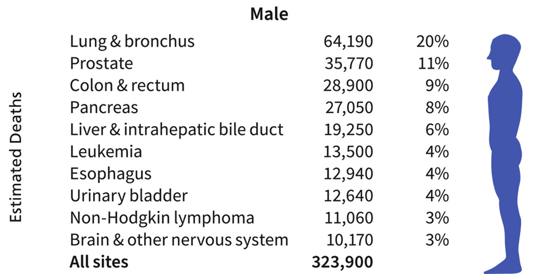
The Burden of Prostate Cancer
In 2025, prostate cancer remains the leading cancer diagnosis in men and the 2nd leading cause of cancer death (and rising!)
American Cancer Society 2025 Cancer Facts and Figures

Slide 15
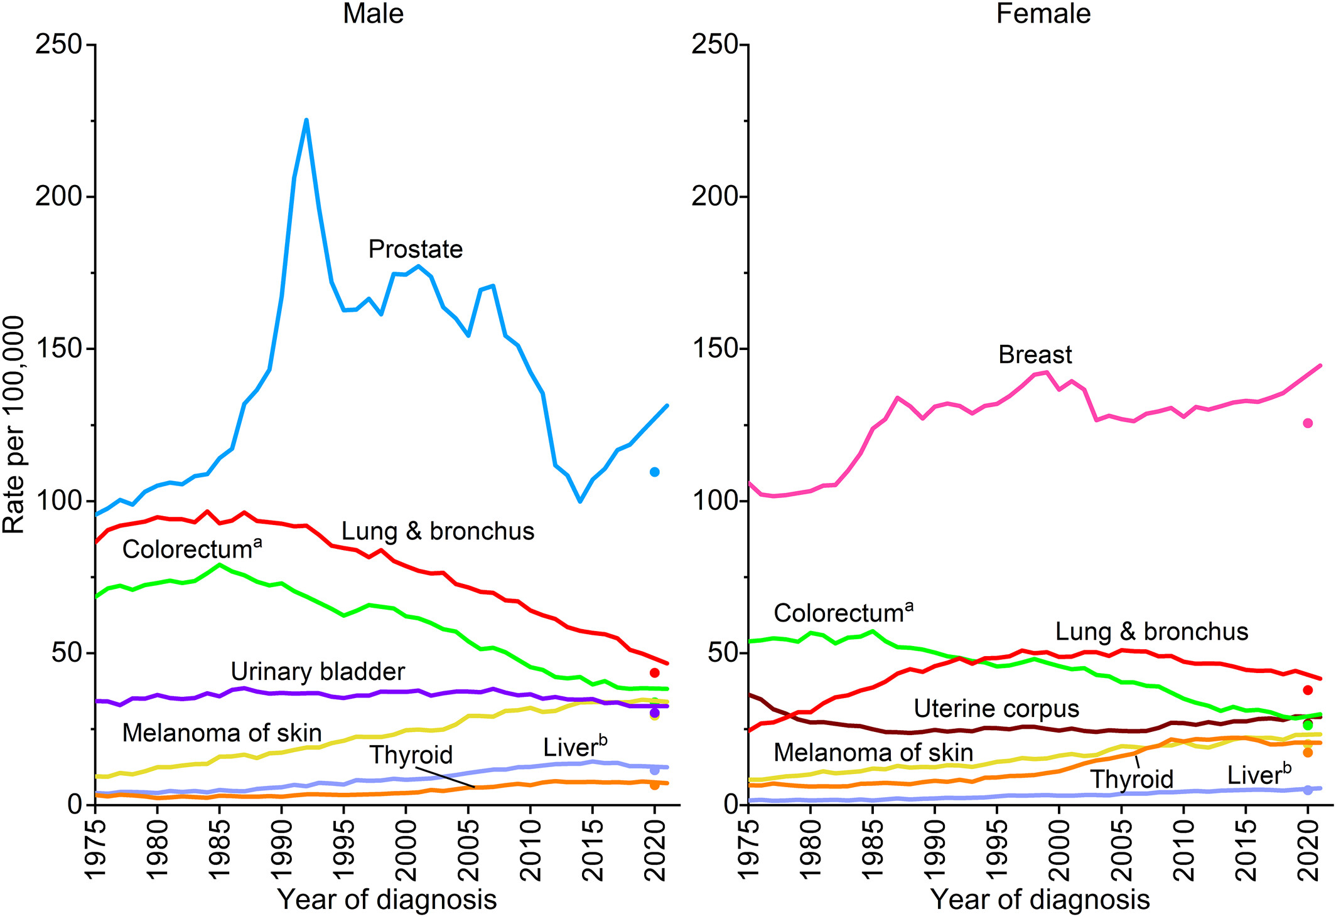
Prostate Cancer Incidence Rising Sharply Since 2014
American Cancer Society 2025 Cancer Facts and Figures

Slide 16
Metastatic Prostate Cancer is Accelerating (B>W)
Schafer E. Eur Urol 84: 117, 2023

Slide 17
Clinically
localized
“Rising PSA”
state
Non-metastatic,
hormone-
sensitive
Non-metastatic
CRPC
Metastatic,
hormone-sensitive
Metastatic
CRPC
Death from prostate cancer
Death from other causes
10-15 years +
Notes:
17
This flow chart shows the clinical states of prostate cancer. Progression from clinically localized disease to metastatic AIPC generally spans 10-15 years or more.

Slide 18
Androgen Deprivation Therapy
Denosumab, Zoledronic Acid
Surgery / Radiation
PARP inhibitors (~23%)
Darolutamide
Apalutamide
Enzalutamide
Abiraterone
Radium-223
Lu-177 PSMA (~90%)
Androgen
Deprivation
Death
Local
Therapy
Therapies After
LHRH Agonists
and Antiandrogens
Docetaxel
Sipuleucel-T
Docetaxel
Cabazitaxel
Pembrolizumab (~3%)
Notes:
Interventional therapy
Surgery, Radiation, Cryosurgery, Brachytherapy in curative setting, not competition
First-line hormonal therapy
LHRH Agents (Lupron, Zoladex, Firmagon) given to metastatic patients to control PSA, disease progression. Most likely to be continued with Abiraterone however a successful head to head trial or early stage combination trial would have profound positive impact on uptake
Antiandrogens
Casodex given with LHRH in an effort at combined androgen blockade or as a second line agent. Clinical trial efficacy is mixed but embraced by HCPs. Antiandrogen withdrawal can actually lower PSA.
Provenge
Immunotherapy launched in Q2 2010. Labeled for mild/asymptomatic mCRPC. Should be direct competitor to 302 indication although patients could receive both drugs. Prostvac-VF is similar agent in development
Taxotere
Chemotherapy is standard of care with prednisone. Patent likely to expire in 2011. Sandwiched between 301 and 302 indications it is a threat.
Jevtana
Follow-on taxane from sanofi-aventis launched in Q3 2010 in post Taxotere failures. Use could delay onset of abiraterone usage in 301 setting.
18

Slide 19
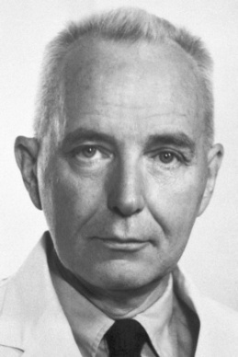
Androgen Receptor Pathway Inhibitors = Targeted Therapy
1941
Huggins and colleagues propose testosterone suppression as PC treatment
2008
First GnRH antagonist (degarelix) approved for treatment of PC
1971
LHRH
structure characterized
1940s-1950s
1950s-1960s
1970s-1980s
1990s-2000s
2010s +
1967
Oral DES considered as effective as orchiectomy in the treatment of PC
1985
First LHRH analogue (leuprolide) approved for treatment of PC
2020
First oral GnRH antagonist (relugolix) approved for treatment of PC

Slide 20
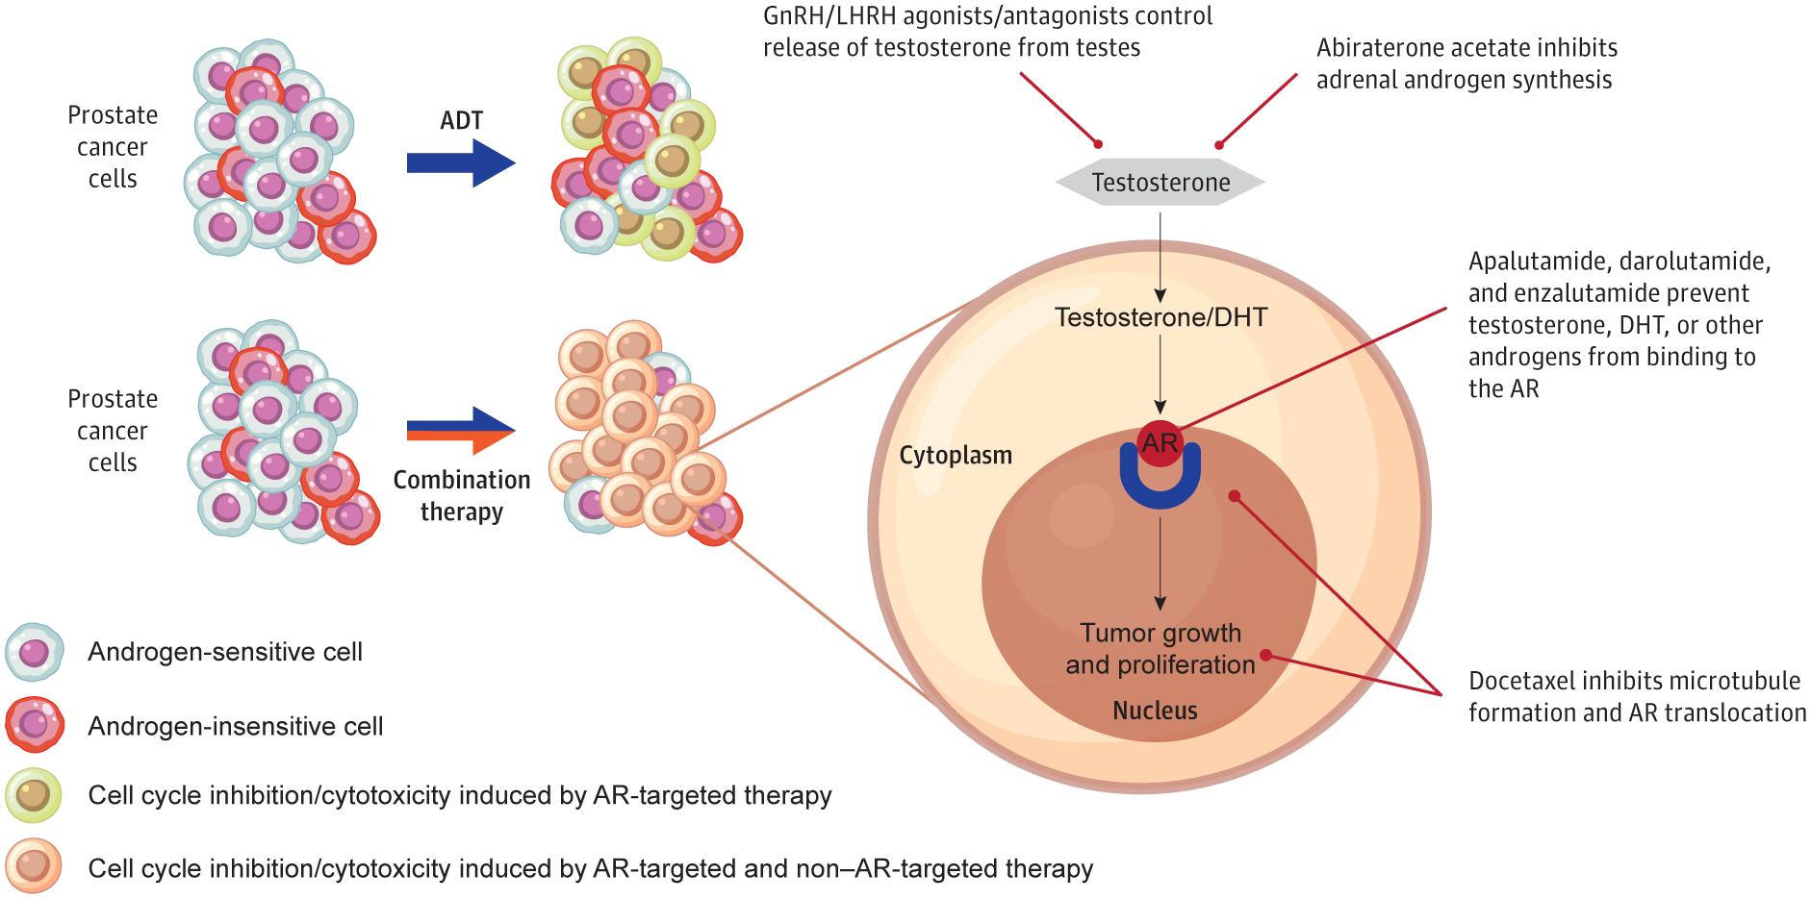
Combination Therapy Targets Tumor Heterogeneity in mHSPC
ARPI:
Abiraterone
ARPI:
Apalutamide Darolutamide
Enzalutamide
Chemo:
Docetaxel
Hussain. JAMA Onc 10:807, 2024

Slide 21
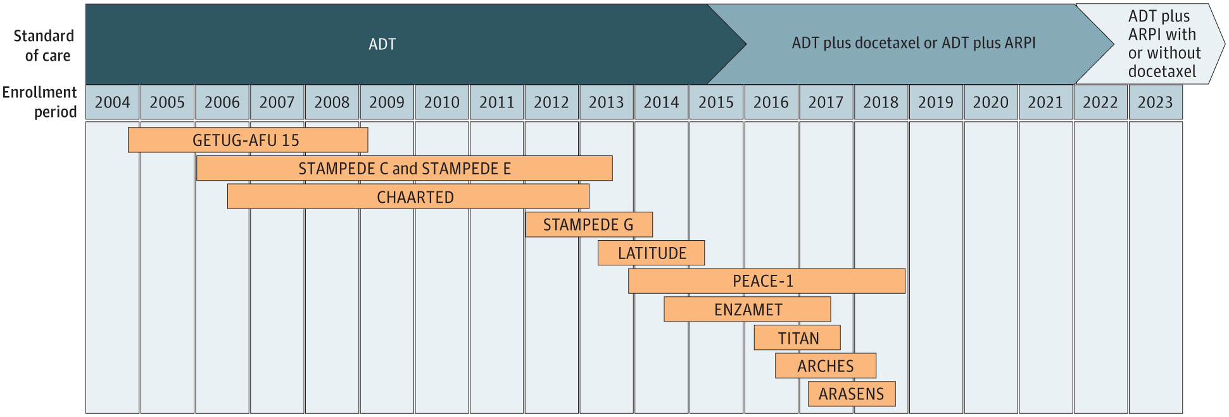
11 Prospective RCTs Demonstrate Significant Survival Benefit for Combination Therapy in mHSPC
ARANOTE
“Doublet” Therapies
[ADT] vs [ADT + ARPI]
HR for OS: 0.63-0.81
“Triplet” Therapies
[ADT + Doce] vs [ADT + Doce + ARPI]
HR for OS: 0.68-0.75
Hussain. JAMA Onc 10:807, 2024

Slide 22

Metastatic Hormone Sensitive Prostate Cancer
ADT + Docetaxel
ADT + ARPI
ADT + Docetaxel + Abiraterone
ADT + Docetaxel + Darolutamide
ADT alone

Slide 23
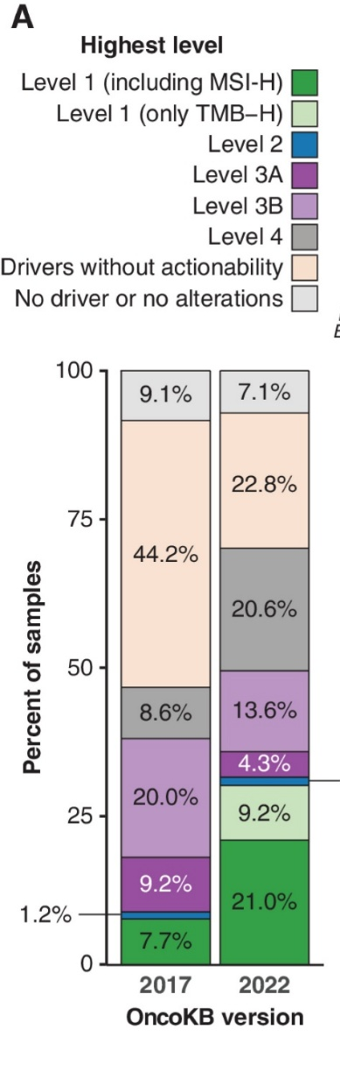
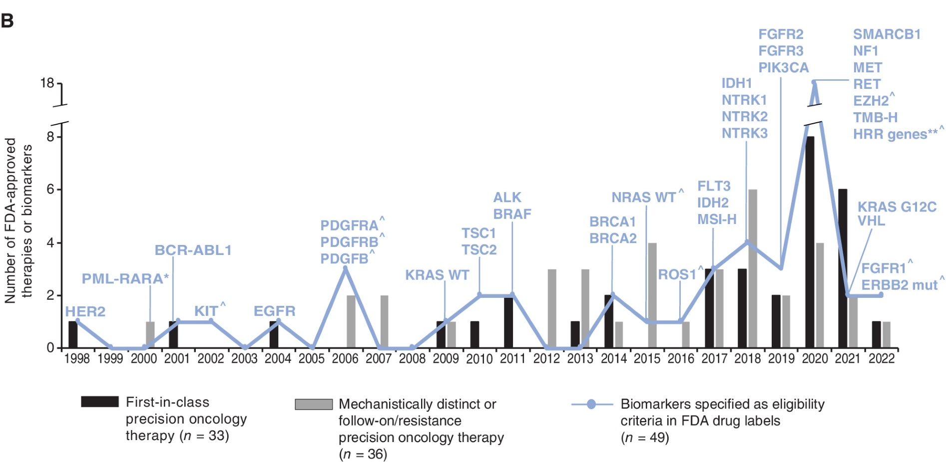
Molecularly-Driven Treatment Decisions Are Becoming More Common
(8.9%→31.6% in 5 yrs)
Suehnholz. Cancer Discov 14:49, 2024

Slide 24
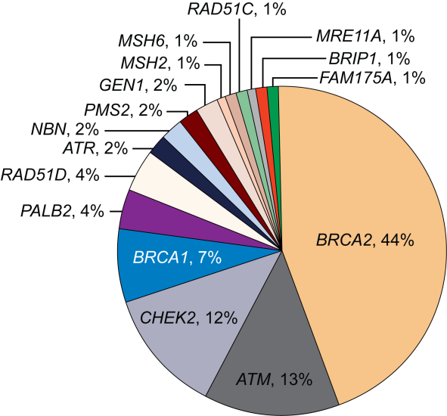
DNA Repair Gene Alterations Are Common in Metastatic Prostate Cancer
23% of mCRPCs harbor DNA damage repair (DDR) alterations
The frequency of DDR mutations increases with disease progression
About half of these (~12%) have germline alterations in DDR genes
Age and family history do not affect mutation frequency

Slide 25
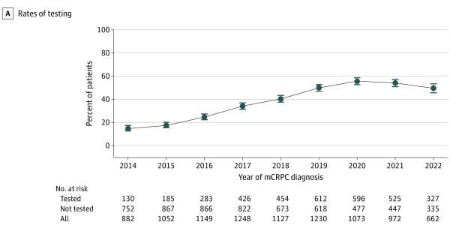
But…
Over 60% of mCRPC Pts Never Get Tested for DDR Mutations
Barata P. JAMA Onc 10(7): 975, 2024

Slide 26
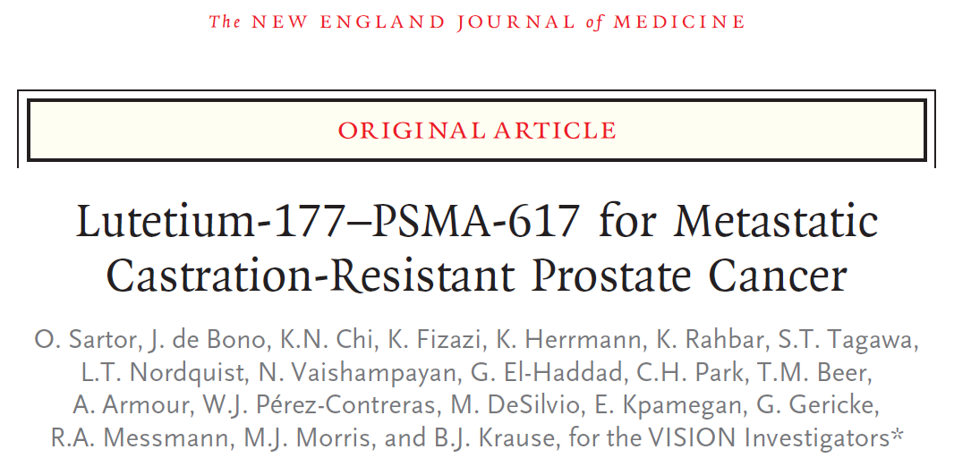
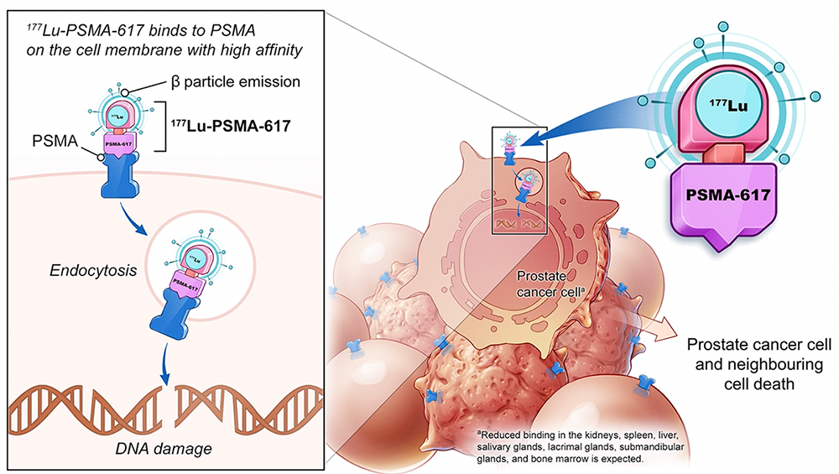
Sartor O. N Engl J Med 385:1091, 2021

Slide 27
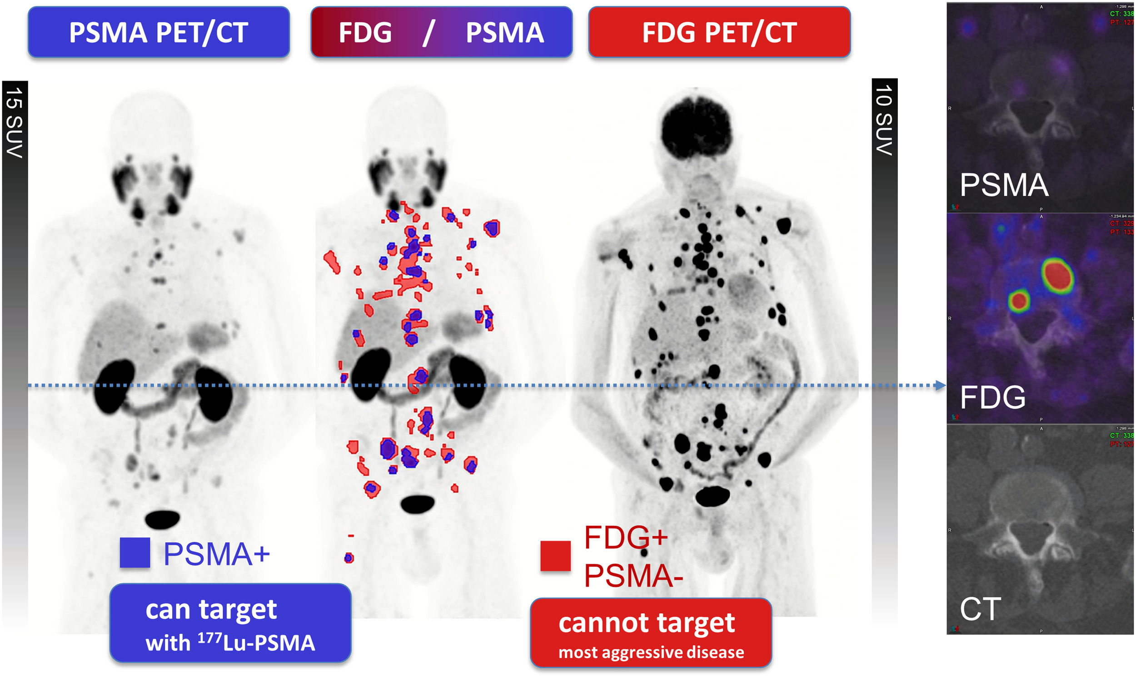

Slide 28
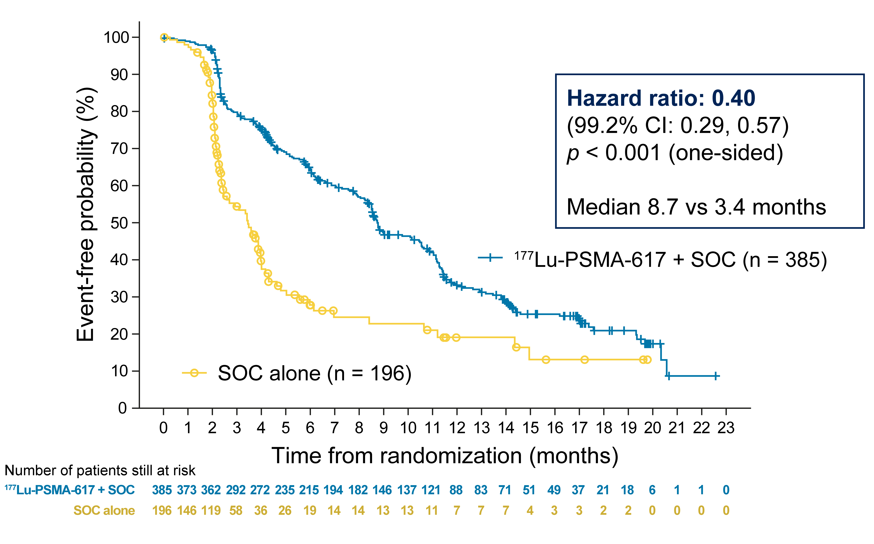
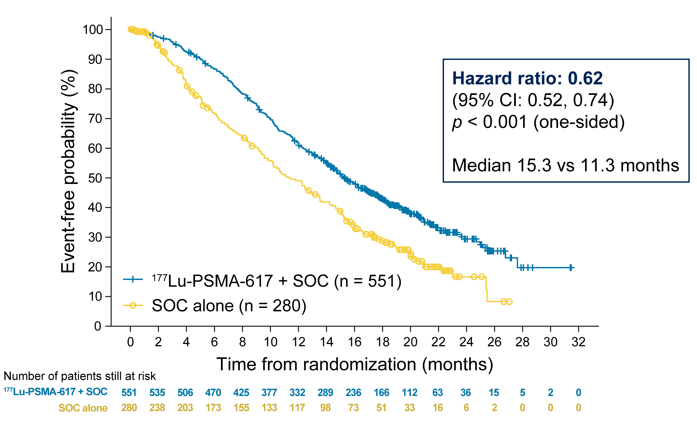
Primary Endpoints: ¹⁷⁷Lu-PSMA-617 Improves rPFS and OS
rPFS
OS
Sartor O. N Engl J Med 385:1091, 2021

Slide 29
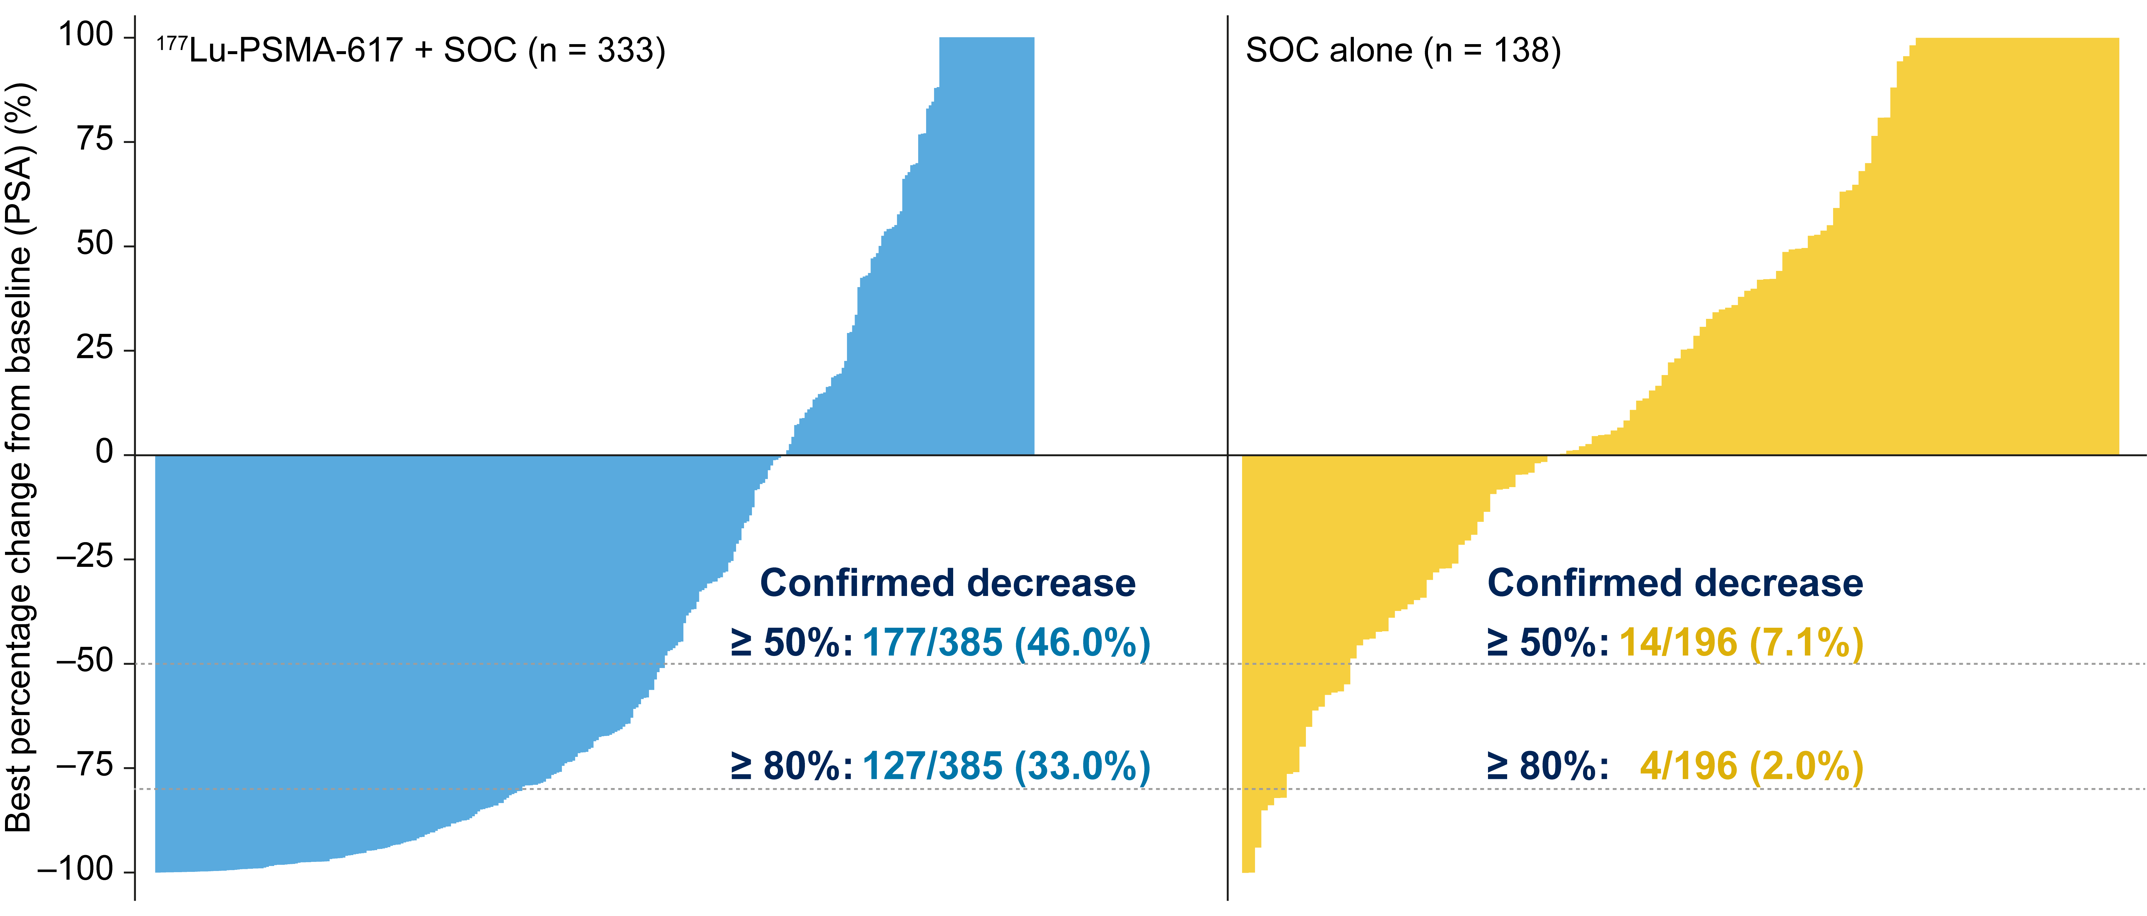
Secondary endpoint: PSA responses favored the
¹⁷⁷Lu-PSMA-617 arm among evaluable patients
Sartor O. N Engl J Med 385:1091, 2021

Slide 30
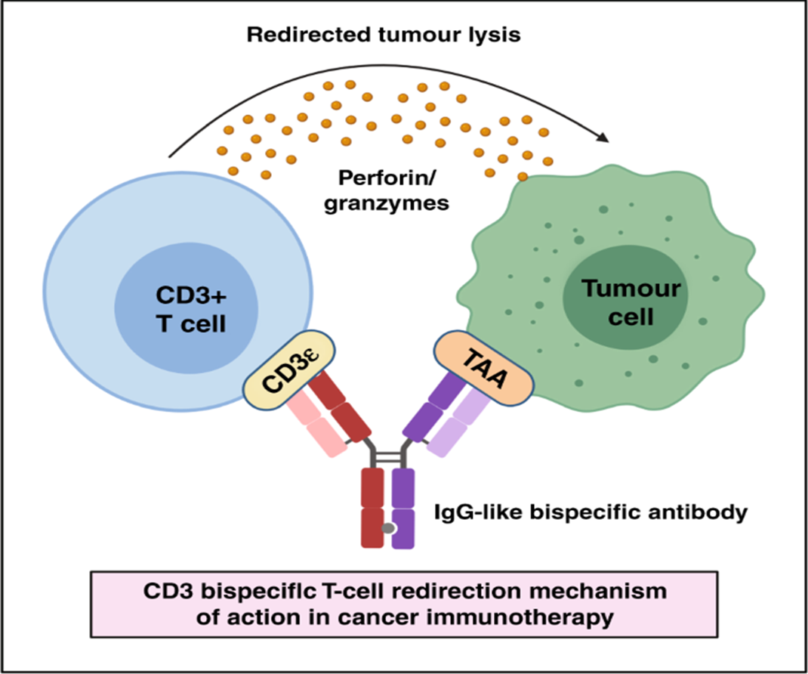
Bispecific T-Cell Engagers (BiTEs)
Targeting PSMA in Prostate Cancer
Amgen AMG 160
Harpoon HPN 424
Janssen 63898081
Tenebio TNB 585
Abbvie CCW702
Regeneron REGN 5678
Janux PSMA-TRACTr
Aptevo APVO442
Xencor XmAb 14484
Amunix XPAT

Slide 31
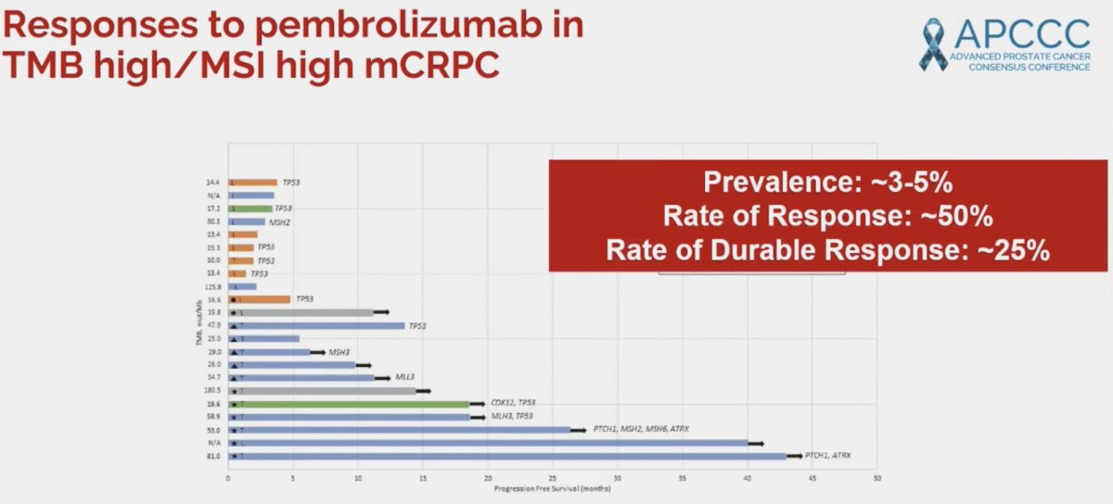
Aparicio A. APCCC 2024

Slide 32
Conclusions: Recent Advances in the Management of Advanced Prostate Cancer
Patients with mHSPC should be considered for combination therapy with at least ADT and ARPI +/- docetaxel
Sequencing mCRPC treatment should be based on biomarkers, prior therapy and clinical status
  HRR mutations→ PARP inhibitors
  PSMA PET→ Lu-177 Radioligand therapy
  Symptomatic progression→ Taxanes
Promising new approaches are coming! (ADCs, RLTs, Bispecifics…)

Slide 33
Thank you!
William K. Oh, MD
Director, Precision Medicine
Yale Cancer Center and Smilow Cancer Hospital
Service Line Medical Director
Smilow Cancer Hospital at Greenwich Hospital
Chair, National Prostate Cancer Roundtable
American Cancer Society

Slide 34
Case (1)
Case (1)
  82 yo white M presents with prostate nodule on exam
  PSA screening tests were done until age 71
  PMH: Afib, GERD, hyperlipidemia, seasonal allergies
  Nocturia 1-2/night
  PSA 17.2 ng/ml
  DRE: firm nodule on R side
  Prostate biopsy: Gleason 4+5=9 (group grade 5)

Slide 35
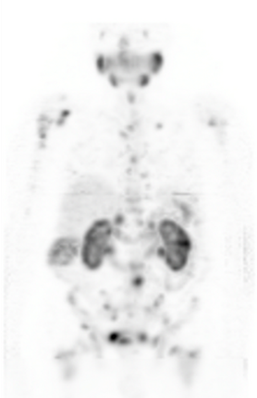
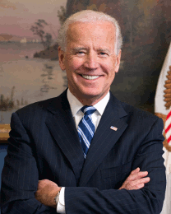
Case (2)
Case (1)
Prostate MRI showed 1.5 cm nodule with extraprostatic extension
PSMA PET/CT scan showed multiple bone lesions

Slide 36
Case (2)
79 yo Korean male with Gleason 9 prostate cancer s/p RP pT3bN0
PSA rose to 13, CT with retroperitoneal LAN, negative bone scan. Starts on ADT
Responds briefly but PSA rising within 1 year
Develops bilateral obstructive uropathy requiring nephrostomy tubes
Abiraterone started with drop in PSA, but rising again in 3 months
FH: 2 brothers with prostate cancer, 1 died of it. His 35 yr old son tested himself and had pathogenic mutation in BRCA2 (c.7480C>T)

Slide 37
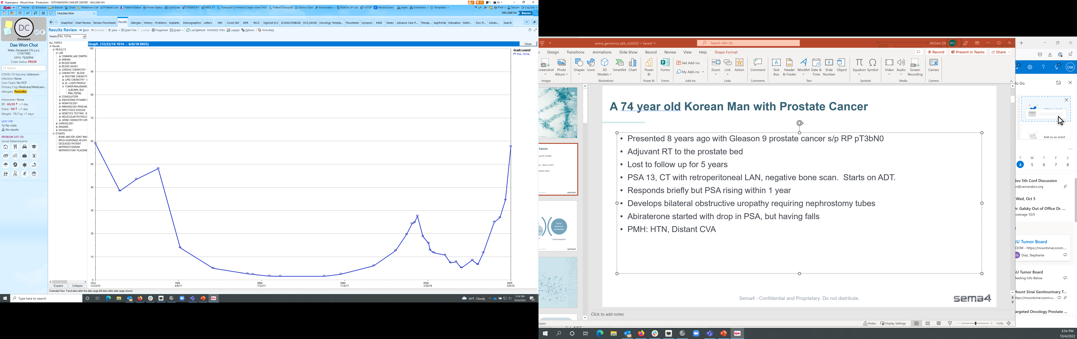
Case (2)
Starts on PARP inhibitor (olaparib) and responds for >1 year
Progresses and is treated with docetaxel to which he has a brief response
Olaparib
Docetaxel

Slide 38

Q&A

Slide 39
Post-Test Poll

Slide 40



LEARNING OPPORTUNITY
Prostate Cancer Screening in Primary Care ECHO Cohort 2
REGISTER TODAY!
6 monthly, hour-long sessions
September 2025 - February 2026
Participation is FREE and OPEN TO ALL
​
This ECHO program helps primary care clinicians navigate prostate cancer screening—covering when to screen, how to minimize harm, interpret PSA results, and refer appropriately—while fostering expert guidance and peer learning.
LINK
If you’re an MD, DO, NP, or PA in Adult Primary Care who handles PSA testing and specialty referrals, this program is for you.
Notes:
Designed to support primary care clinicians in navigating the complexities of prostate cancer screening, this ECHO program tackles key challenges—including when to initiate screening, how to identify appropriate candidates, minimize harm and overdiagnosis, interpret PSA results, and determine the right time for referral. It also offers a collaborative space for case sharing, expert insights, and peer-to-peer learning.
Drop link in chat: bit.ly/4iYZ0Zf

Slide 41
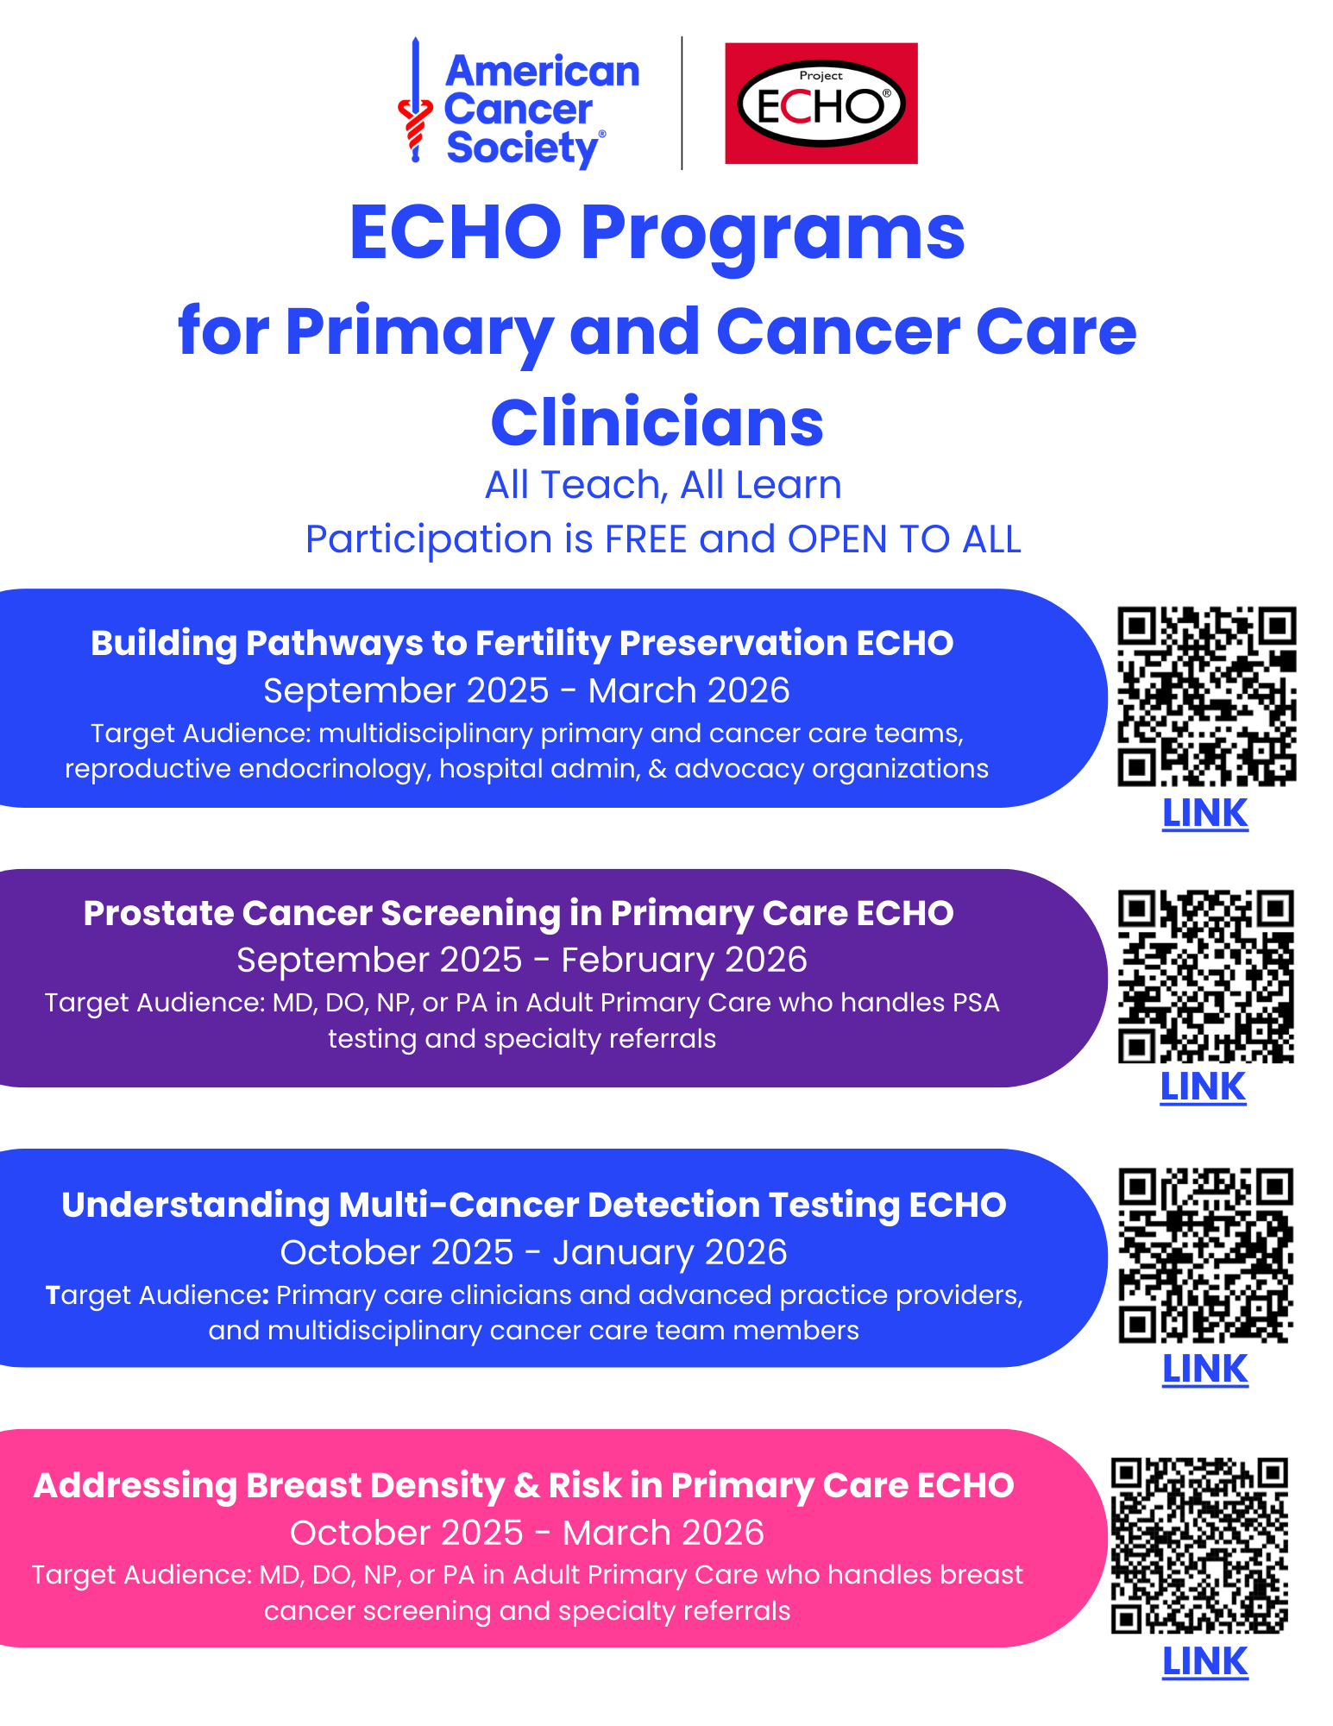
REGISTER TODAY!
The Project ECHO virtual training series is designed to support primary care clinicians and multidisciplinary teams in cancer-related screening, risk management, and care coordination.
Each program features expert-led sessions, peer-to-peer learning, and practical tools to enhance clinical decision-making and improve patient outcomes.
Register for a program of your interest for FREE today.

Slide 42
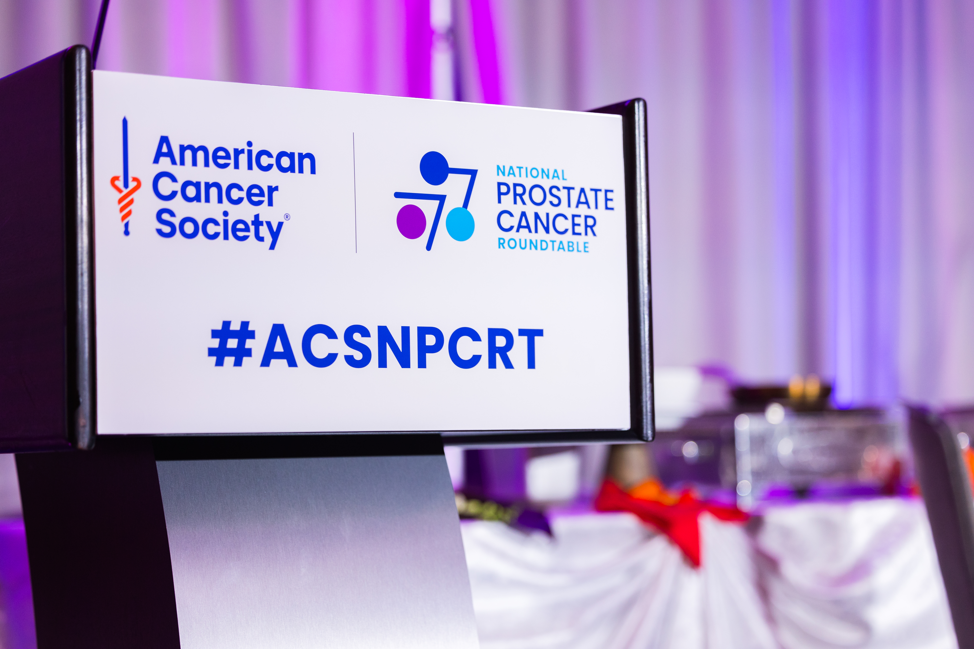
Stay Connected with ACS NPCRT
Website: npcrt.org
LinkedIn: American Cancer Society National Prostate Cancer Roundtable
X: @NPCRTnews
Newsletter: Sign up at npcrt.org/about-us/
42

Slide 43

Thank You
Npcrt.org

